Slide 1
The Statistics of Time Transfer
W.J. Riley
2016 Precise Time and Time Interval (PTTI) Meeting
Monterey, CA USA
Tutorial
January 25, 2016
Rev A 02/12/16
Notes:
This tutorial is an introduction to the statistics involved in time transfer processes. These measures of time deviation are closely related to the tools used for the analysis of frequency stability. In particular, the TDEV statistic, based on the modified Allan deviation (MDEV) is a particularly useful way to characterize the noise of a time transfer system. There are, of course, other mechanisms besides noise that can affect the performance of a time transfer system, and some of those are also described. The tutorial uses the example of basic one way GPS time transfer to illustrate some of the analytical techniques involved.
Revision A of this tutorial substitutes a different set of GPSDO data in the example at the end.

Slide 2
Introduction
Time transfer is the process of transmitting time information from one place to another. It can also be used to convey frequency information since frequency is the rate of change of phase.
The performance of a time or frequency transfer system can be characterized by several specialized statistical measures.
Those measures are based on the properties of the underlying noise affecting the system, based on certain definitions and statistical tools used for the analysis of time and frequency stability.
As we shall see, the principle measure of the noise associated with a time transfer is the Time Deviation, TDEV.
Notes:
While emphasizing time transfer systems, we shall also mention those for frequency transfer since the same systems are often be used for both.
The specialized statistical tools used for time and frequency analysis are based on definitions of phase and frequency fluctuations having power law spectral densities. Those definitions and noise types, and the statistics used to characterize them, are the subject of this tutorial. More general information about time and frequency analysis will be found in Reference 1, information about GPS time and frequency will be found in Reference 2, and information about TDEV will be found in Reference 3.

Slide 3
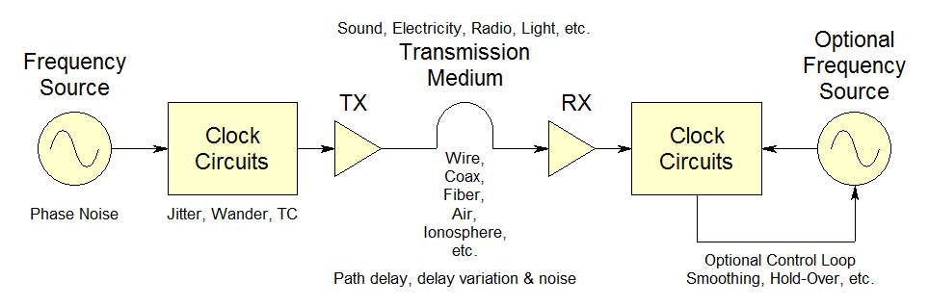
A Time Transfer System
A representative one-way time transfer system is shown below:
The time at the far end is subject to variations caused by the frequency
source, the clock, TX & RX circuits and the transmission medium
whose noise properties we wish to describe.
Notes:
This slide shows a generalized one-way time transfer system. One could think of the primary frequency source as a pendulum clock, with a set of gears representing the clockworks to ring a bell as the transmitter. The transmission medium would be a sound wave through the air, with a path delay dependent on distance, the speed of sound, temperature and pressure variations, with extraneous background noise, both steady and transient. The receiving ear would, with a certain latency, set the clock at the other end of the path. If, over time, the clock corrections were all similar, the pendulum of the remote clock would be adjusted. That would make the remote time more accurate between time transfers, especially if some were missing. Multiple time transfer clients could, of course, utilize the sound of the bell.
The biggest uncertainty in the one-way time transfer process is determining the path delay. If a two-way scheme were adopted by also ringing a bell at the far end and measuring the round trip time for it to be heard at the source, a good estimate could be made for the one way delay and latency.
Another scheme would be for the timekeepers at both ends to read their clocks upon hearing a common event (a cannon?), which would not have to occur at any particular time, but still requires knowledge of the differential path delays between each clock and the common event.
A nice comparison between these one-way, two-way and common view methods is found in: J. Levine, “A Review of Time and Frequency Transfer Methods”, Metrologia, Volume 45, S162-S174, 2008.
We could, of course, also transfer time by physically transporting the clock from one location to another, but that’s another story altogether.

Slide 4
Time Transfer Performance
Accuracy
  Positioning, Calibration, Error Budget
Noise, Scatter, Jitter, Variability
  The Main Topic of this Talk - Statistics
Drift, Wandering
  A Secondary Topic of this Talk – Fits & Models
Environmental Sensitivity, TC, EMI
  Similar Measurements Used to Assess Sensitivities
Jumps, Lurches, Glitches, Outliers
  Must Be Dealt With to Analyze Noise, etc.
Notes:
The accuracy of a time transfer depends on knowing one’s location (distance from the source) as well an assessment of all the factors that add path delay, including signal propagation, cable lengths, electronic phase shifts and software latency. These factors often require calibration, and can be expressed in an error budget to estimate the overall accuracy.
Noise and related stochastic factors contribute non-deterministic scatter, jitter and other variability in the time transfer, and are treated in statistical terms that are closely related to those used for analyzing the stability of active frequency sources, often after removing or controlling for such deterministic factors as drift and environmental sensitivity.
Other longer-term behavior such as drift and wandering may be a combination of stochastic and deterministic factors, and can be difficult to distinguish between.
In addition, jumps, lurches, glitches and the like can cause additional variation and/or outliers that must be removed before a meaningful analysis can proceed. All such problems should be investigated in an effort to identify, understand and eliminate their root cause, especially since automatic suppression of such effects is difficult.
Timekeeping is hard, especially since it must be continuous without either interruption or end, and reliability is of the essence. Effective means for time transfer can remove much of the burden for individual users of precise time by allowing remote startup and recovery, and by reducing the need for primary clock management. Nevertheless, where critical timing, timestamping or synchronization is required, every effort must be made to assure failsafe reliability, including holdover means to mitigate disruptions in the time transfer process. Means may also be required to monitor time transfer performance.
So the statistical analysis of normal time transfer variability is perhaps the easiest part of evaluating a time transfer system.

Slide 5
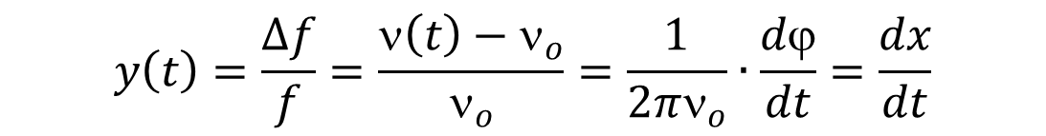
Definitions
A time transfer system can be modeled as a sinusoidal
signal whose phase is measured at a remote location.
We are primarily interested in the phase deviation, φ(t),
and the corresponding time deviation x(t)=φ(t)/2πν₀
We can also define the fractional frequency deviation as:
Notes:
x(t) and y(t) are the quantities most often used for frequency stability analysis. x(t) is the time deviation in units of seconds, but is commonly called “phase” to distinguish it from real time. y(t) is the dimensionless fractional frequency deviation, expressed as a value like 1e-11, 1x10⁻¹¹, 1pp10^11 or 1pp10¹¹, where pp is “parts per”. Note the positive exponent for the pp case, and that fractional frequency does not have any units like Hz. Note also that Δf/f = Δt/t so that a fractional frequency offset of 1x10⁻¹¹ corresponds to a phase change of 1x10⁻¹¹ s/s = 10 ps/s. The fundamental relationship is that frequency is the rate of change of phase. A time transfer system can therefore be used to transfer frequency information by observing how fast the phase (or time) changes between the local and remote clocks. A phase value can be measured instantaneously while a frequency value must be measured over some finite observation time. The time between phase measurements or that of a frequency measurement is called τ (tau), and both x(t) and y(t) are functions of τ.

Slide 6

Time Transfer Noise
The frequency source, clock, transmitter & receiver circuits,
and the transmission medium can be considered to have
noise mechanisms that have power law spectral densities
and corresponding time domain statistical properties of
their frequency fluctuations:
Power Law Exponent, α | Noise Type
0 | White
-1 | Flicker
-2 | Random Walk
-3 | Flicker Walk
Notes:
These noise types can apply to both phase and frequency data. Integration, the process of converting frequency to phase, is the 1/s Laplace operator, equivalent to 1/f, so it changes the power law exponent α by -2. Therefore we have a hierarchy of noise types from white PM (α=2), flicker PM (α=1), white FM (α=0), flicker FM (α=-1), random walk FM (α=-2).
Most time transfer systems have white and flicker PM as their dominant noise type because the quantity of interest is phase (time) and the transmission path generally has white or flicker additive noise. The dominant noise type for passive atomic frequency standards (e.g., Rb oscillators) is white FM noise. Crystal oscillators display a wide range of phase noise types from the more divergent f⁻³ near the carrier to f⁰ at high sideband frequencies. A overall time transfer system comprising a disciplined RFS or OCVCXO may have several of these noise types at various averaging times.

Slide 7
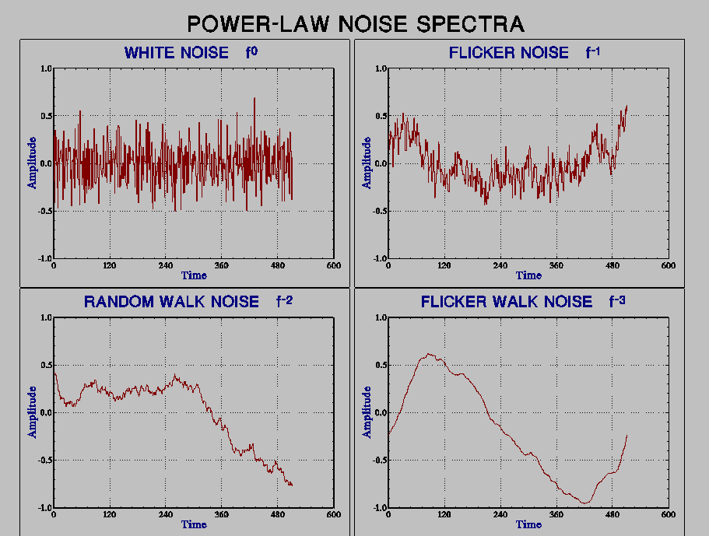
Power Law Noise
Notes:
These plots can apply to either phase or frequency data. White noise is uncorrelated – each sample is independent of its adjacent neighbors, and its autocorrelation is zero at all lags >0. Flicker, random walk and flicker walk noise have increasing degrees of autocorrelation. White and flicker noise appears just about everywhere in every sort of device and thing. Random walk noise is also common in physical processes – it is the path of a succession of random steps that gradually diverges from its starting point. The more divergent flicker walk and flicker run processes may be integrated versions of flicker and random walk noise, and they can be hard to distinguish from environmental sensitivity.
For the purposes of time and frequency stability analysis, we generally exclude deterministic effects like temperature sensitivity and aging, preferring to either avoid or remove those effects before analyzing the noise.

Slide 8
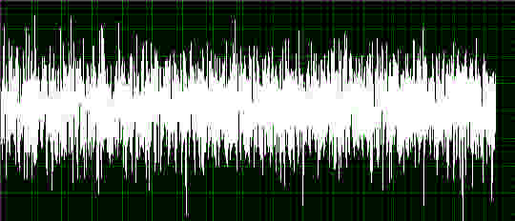
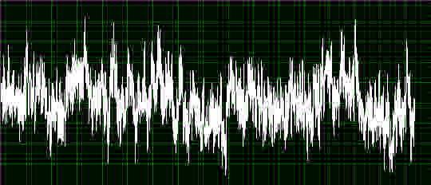
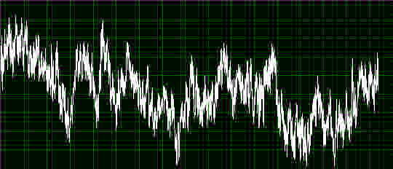
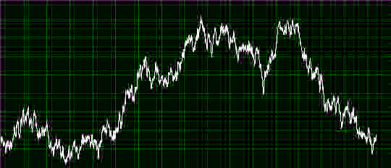
More Power Law Noise
α=0 White Noise
α=-1 Flicker Noise
α=-1.5 Flicker/RW Noise
α=-2 Random Walk Noise
Notes:
Here are some more pictures of power law noise. Notice that the exponent does not have to be an integer, and α=1.5 represents an intermediate case between flicker and random walk noise. These noise types are sometimes identified by their spectral “colors”, with white signifying flat amplitude versus Fourier frequency (as in the case of so-called white light), pink denoting 1/f or flicker noise (-3 dB/octave), and red denoting 1/f² or random walk noise (-6 dB/octave). Note however that the f^{α} is sometimes used with the opposite sign, and that the colors may be defined differently (e.g., brown=Brownian=1/f² and black=1/f^{>2}).

Slide 9
Time Domain Stability Statistics
Standard Deviation
  Familiar, But Doesn’t Converge for α < 0
Allan Deviation
  Most Commonly Used Measure of Frequency Stability
Modified Allan Deviation
  Especially Suitable for Analyzing Phase Fluctuations
Time Deviation
  Preferred Measure of Time Interval Error
  Based on Modified Allan Deviation
TIE rms
  Another Common Measure of Time Interval Error
Notes:
Here we list the major statistics used to analyze the noise associated with a time transfer process. The standard deviation doesn’t converge for common clock noises. The Allan deviation does, but emphasizes frequency stability. The modified Allan deviation has the advantage of distinguishing between white and flicker phase noise that is common in time transfer paths. The time deviation has that advantage and also emphasizes phase and time stability, so it is particularly suited for characterizing time transfer systems. Use of the rms time error is best limited to cases of white PM noise.

Slide 10
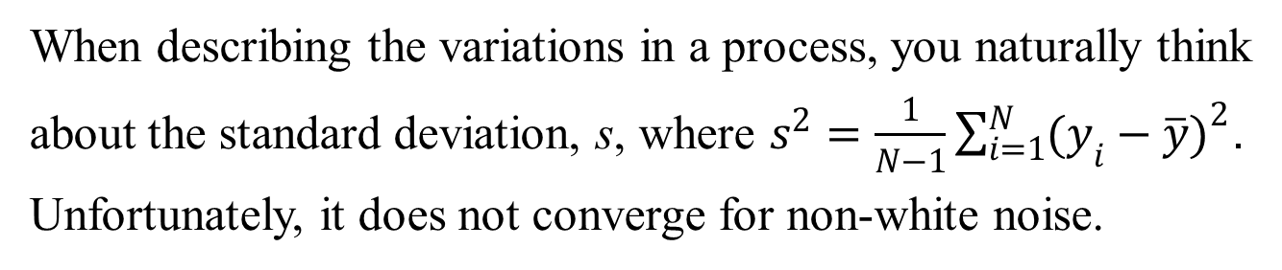
Standard Deviation
Blue=Std Dev
Red=ADEV
Notes:
The problem with the standard variance is that the mean is not well-defined for divergent noise types. The Allan variance avoids this problem by using first differences of the fractional frequency.

Slide 11
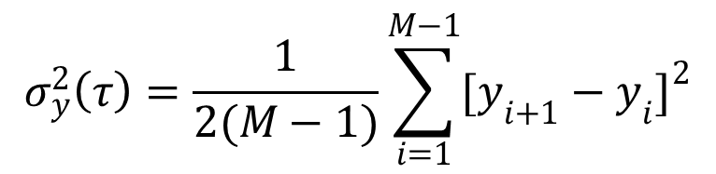
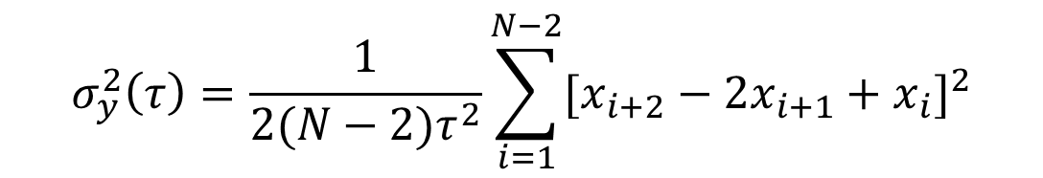
Allan Deviation, ADEV
The 2-sample or Allan variance is the preferred measure
of frequency stability, whose basic estimator is given by:
1st differences
of frequency
The Allan deviation is σ_{y}(τ) the square root of the Allan
variance. In terms of phase data:
2nd differences
of phase
Other forms of these estimators can provide better confidence.
Notes:
Note that the ADEV or σ_{y}(τ) or sigma-y is a function of the averaging time, ταυ. ADEV is usually shown versus tau on a log-log plot, and the slope of log(σ) ϖερσυσ λογ(τ) indicates the power law noise type (see Slide #15).
Note also that the number of frequency data points, y_{i}, is, by convention, called M=N-1, where N is the number of phase data points, x_{i}. Because the frequency values are the first differences of the phase, there is one fewer frequency value.
See Reference 1 for information about other ADEV estimators for both phase and frequency data, and other members of the Allan variance family (e.g., the Total variance and Thêo1). For time transfer, the most important statistics besides ADEV are MDEV (see Slide #11) and TDEV (see Slide #13).

Slide 12
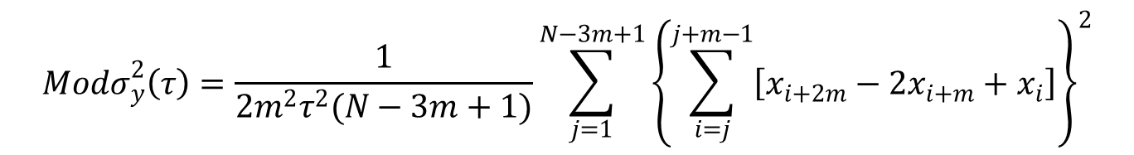
Modified Allan Deviation, MDEV
The Modified Allan variance includes an additional phase averaging
operation that enhances its ability to distinguish between white and
flicker PM noise. Its fully-overlapping estimator is shown here for
N phase data points and an averaging factor of m:
The MDEV has the same expected value as the ADEV for m=1, and is smaller than ADEV for averaging factor >1.
Notes:
The confidence level of the basic AVAR estimators shown in Slide #11 can be improved by forming their fully-overlapping equivalents (see Reference 1). For example, the fully-overlapping AVAR estimators for phase and frequency data are: $σ_{y}^{2}\left(τ\right)=\frac{1}{2(N−2m)τ^{2}}\sum_{i=1}^{N−2m}{{[x_{i+2m}−2x_{i+m}+x_{i}]}^{2}}$ = $σ_{y}^{2}\left(τ\right)=\frac{1}{2m^{2}(M−2m+1)}\sum_{j=1}^{M−2m+1}{{\left\{\sum_{i=j}^{j+m−1}{\left(y_{i+m}−y_{i}\right)}\right\}}^{2}}.$
The fully-overlapping estimators use all possible 2nd or 1st differences to increase the number of degrees of freedom and narrow the error bars.
Since phase data is “averaged” to a longer tau by simple downsampling rather than arithmetic averaging, this expression for calculating MDEV from phase data contains two rather than three summations, and is therefore better for computational purposes than that for frequency data (again see Reference 1).

Slide 13
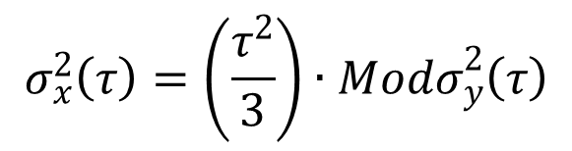
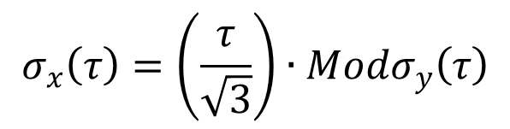
Time Deviation, TDEV
The time variance, TVAR or σ²_{x}(τ), is based on the Modified
Allan variance, and the time deviation, TDEV or σ_{x}(τ), is its
square root. The scaling factor makes TDEV equal to the standard
Variance of the time deviations for white PM noise.
TDEV is the product of a frequency deviation (a rate of change of a phase) times time, where the frequency deviation term distinguishes between white and flicker PM noise, and is scaled so that it equals the classical standard deviation of the phase fluctuations for white PM noise at τ=τ₀.
Notes:
TDEV (see Reference 3) is generally the statistic of choice to describe the noise performance of a time transfer system, particularly if it is plotted as a function of averaging time. σ_{x}(τ) varies as τ^{-1/2} for white PM, is flat versus τ for flicker PM, and rises as τ^{1/2}, τ and τ^{3/2} for white, flicker and random walk FM noise respectively.
TDEV is also a very useful measure of the timekeeping ability of a frequency source. For example, the critical period for a GPS satellite clock is the 1 day interval between normal ground updates. So its 1-day TDEV nicely expresses the time error that can be expected over that interval due to its noise. The best GPS Rb clocks have a white FM noise level slightly below 1x10⁻¹²τ^{-1/2} down to a flicker floor of low pp10¹⁵. Their 1-day TDEV is only about 0.1 ns, so they contribute very little to the GPS time transfer error.
Because of the close relationship between MDEV and TDEV, one can show loci of constant TDEV on an MDEV plot (and vice-versa).

Slide 14
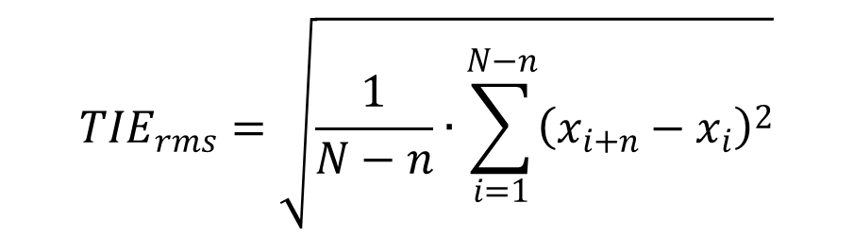
RMS Time Interval Error, TIE rms
The rms time interval error, TIE rms, is another measure of
time variability. For no frequency offset, it is approximately
equal to the standard deviation of the fractional frequency
fluctuations multiplied by the averaging time.
TDEV is, however, a better measure of time deviation for
divergent noise types.
Notes:
TIE rms is mentioned here just for completeness, but it can be a useful measure of time error caused by a white PM noise process.

Slide 15
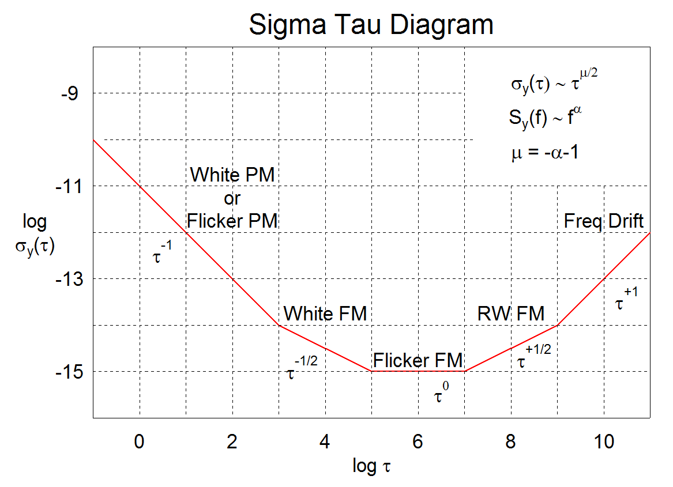
Sigma–Tau Plot
Notes:
Sigma-tau plots are the most common way to show frequency stability. They not only show stability versus averaging time, but the slope of the log(sigma) versus log(tau) characteristic indicates the power law noise type. A sigma-tau stability plot for the noise of a time transfer can not only quantify the noise but also help identify its type and possibly its source. But, since the noise associated with a time transfer path is often white or flicker phase noise, a Mod-sigma versus tau plot (see Slide #16) can also be useful.

Slide 16
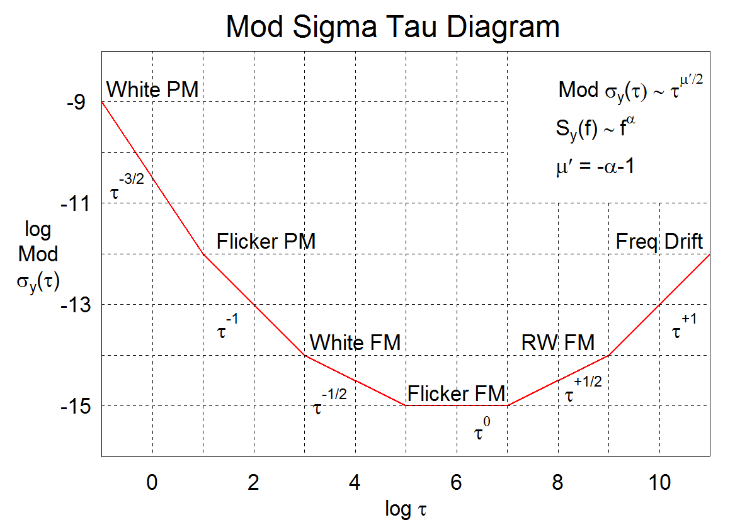
Mod Sigma–Tau Plot
Notes:
A sigma-tau plot can also be used with the MDEV. Notice that the log slopes for white and flicker phase noise are different on a Mod Sigma-Tau plot.

Slide 17
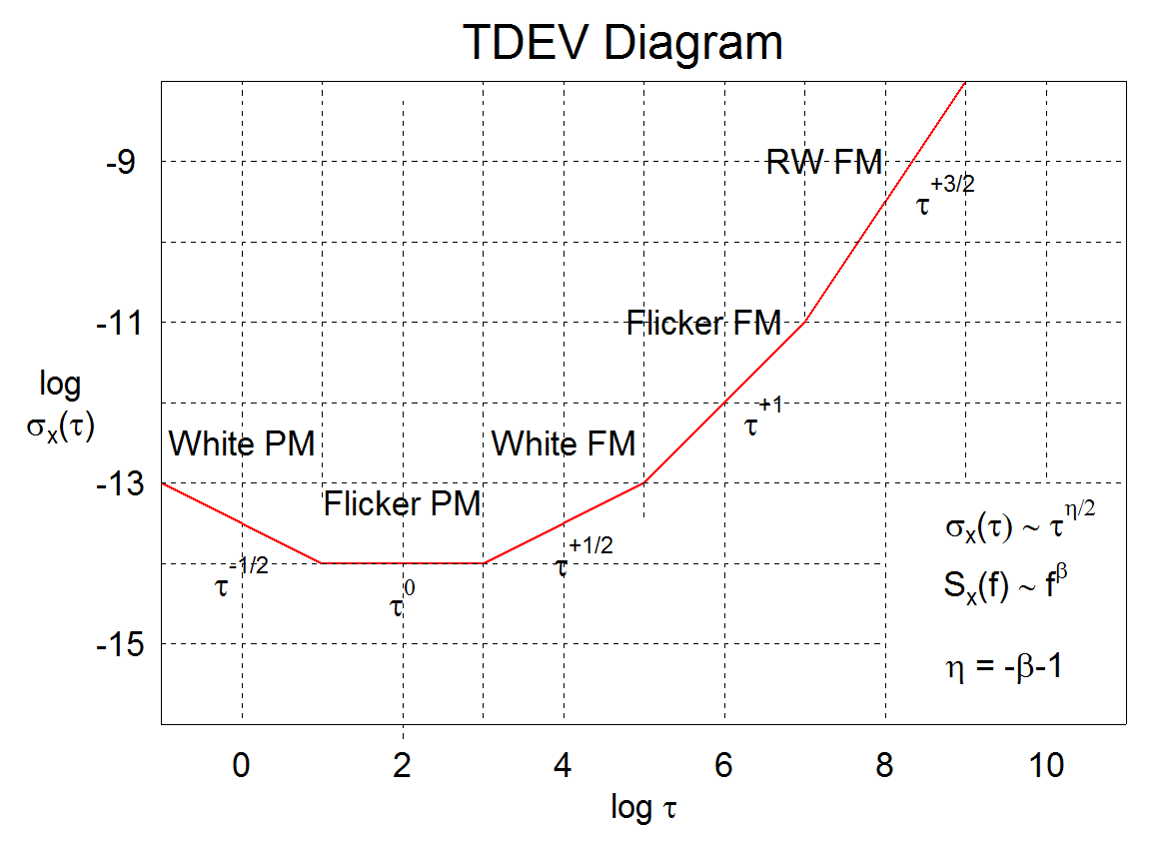
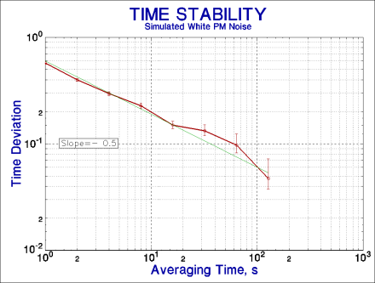
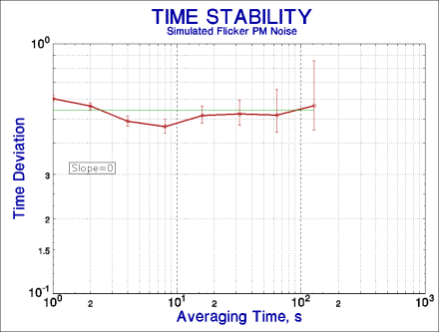
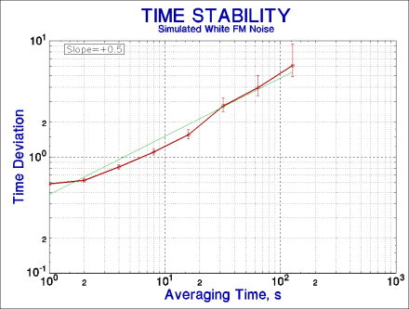
TDEV – Tau Plot
Notes:
A log TDEV versus log tau can also be drawn, and, like a MDEV plot, can distinguish between white and flicker PM noise. The TDEV of a time transfer path subject to white phase noise improves as the square root of the averaging time, while the TDEV a path with flicker PM noise is independent of averaging time, so the time deviation of a typical time transfer path with a combination of white and flicker PM noise improves only slightly with longer averaging. FM noise is less common, but an example is Doppler shift caused by a moving ionospheric layer. The small plots show the TDEV slopes for simulated white PM (top), flicker PM (middle) and white FM (bottom) noise.

Slide 18
Summary of Stability Plot Noise Slopes
Noise Type | α | Stability Plot Noise Slope
 |  | ADEV | MDEV | TDEV
White PM | +2 | -1 | -3/2 | -1/2
Flicker PM | +1 | -1 | -1 | 0
Random Walk PM or White PM | 0 | -1/2 | -1/2 | +1/2
Flicker FM | -1 | 0 | 0 | +1
Random Walk FM | -2 | +1/2 | +1/2 | +3/2
Notes:
Once again, the log-log slope of the noise characteristic on an ADEV, MDEV or TDEV stability plot can be used to identify the noise type. This can be very useful information for determining the source of the noise, assessing its effects, reducing it and characterizing it in the frequency domain.

Slide 19
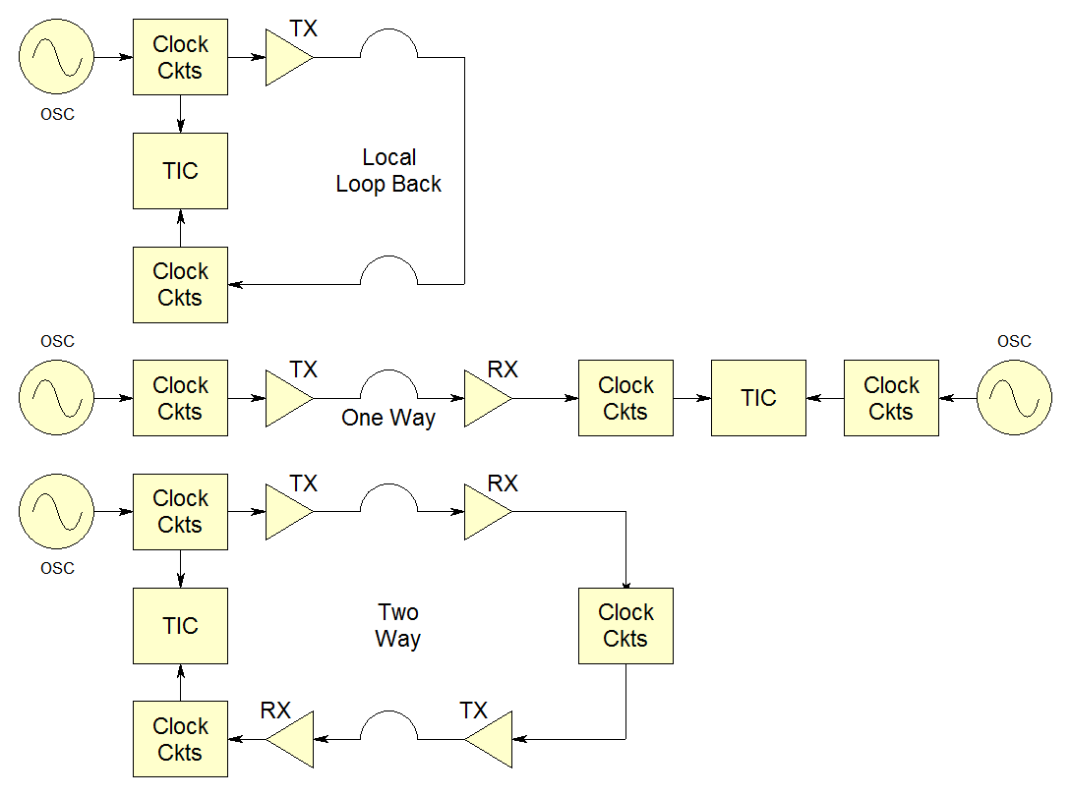
Time Transfer Measurements
Examples:
Ethernet or coax cable, spool of optical fiber
Resembles
WWV, Loran,
1-way GPS
Resembles
NTP, GPS CV,TWSTFT
Notes:
This figure shows three basic ways to measure the performance of a time transfer system. The first, at the top, loops the time transfer signal back to its source where a comparison can be made against the transmitted signal. That method is particularly suitable for a fiber optic path. The second, shown in the center, uses a one way path (perhaps the actual one) and measures the received signal against a high stability source at the far end. The third arrangement at the bottom, employs a two way path that allows the time transfer performance to be assessed at the origin. In all three of these schemes, the measurements are made with a time interval counter (TIC).

Slide 20
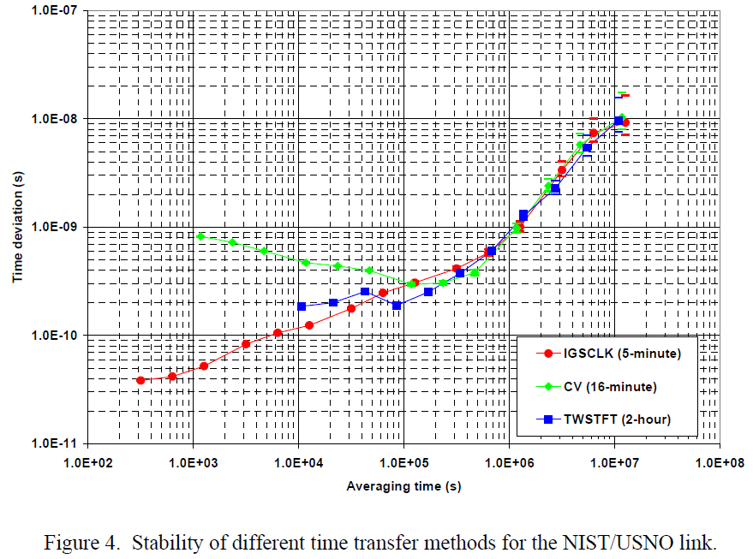
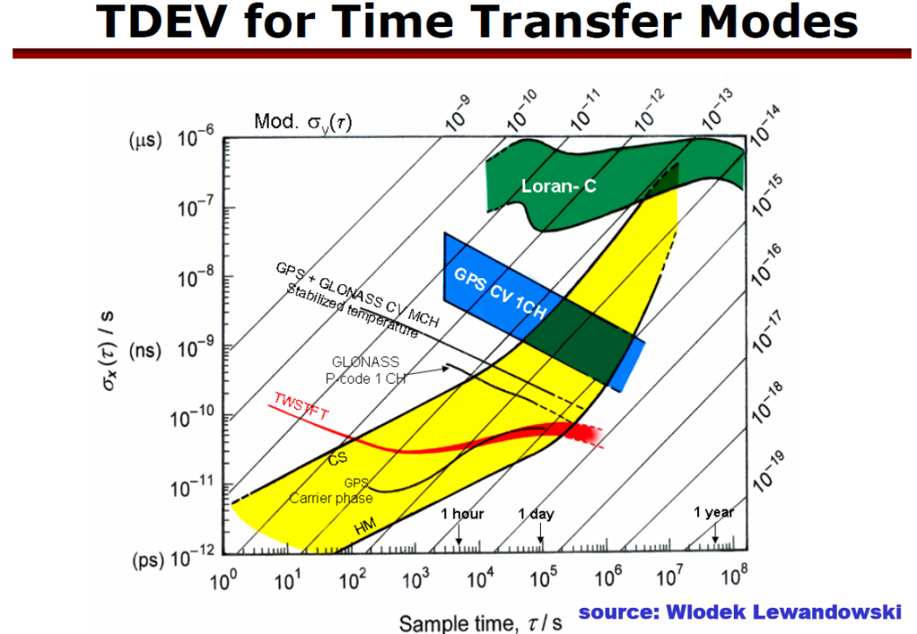
Examples of Time Transfer TDEV Plots
Credit: V. Zhang, T. Parker & M. Weiss/NIST
39th PTTI Meeting, 2007
Credit: D. Matsakis/USNO
2009 Time Transfer Tutorial Material
The performance of a time transfer system is commonly shown
as a plot of TDEV versus averaging time.
Notes:
This slide shows examples of TDEV plots for several time transfer methods (GPS common view and TWSTFT on the left, Loran-C, GPS CV & carrier phase and TWSTFT on the right, along with Cs and H-maser frequency standards and superimposed loci of constant MDEV). You will find much information in the technical literature regarding the performance of various time and frequency transfer methods, usually with the results expressed as TDEV versus tau as shown here.

Slide 21
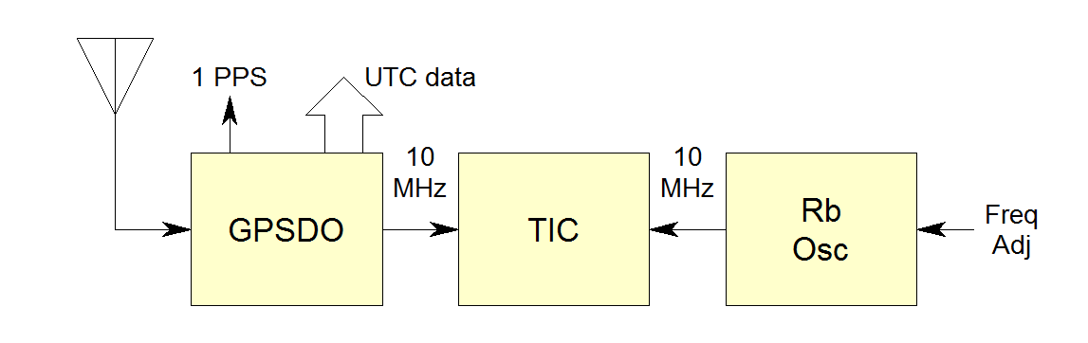
Example of a GPS T/F Transfer
The GPS disciplined oscillator produces a smoothed 10 MHz output from an internal TCXO locked to the GPS timing signal. The time interval counter measures the relative phase of the Rb oscillator versus the GPSDO at 1 second intervals. Those data are used to determine the frequency offset of the Rb oscillator and allow it to be calibrated against GPS. The GPSDO also provides UTC data and a smoothed 1 PPS clock output.
Notes:
The useful outputs from the GPS disciplined oscillator are (1) a smoothed 1 pps timing pulses, (2) UTC time data, and (3) a smoothed 10 MHz frequency reference. A GPSDO provides an absolute local time and frequency reference along with positioning information to support the time reference, all at relatively low cost. In the data that follows, the GPSDO is a Jackson Labs GPSTCXO, the Rb oscillator is a Datum LPRO, and the time interval counter is custom-made moderately high resolution DDS phase measurement device described in a paper at the 2016 PTTI Meeting (See: W.J. Riley, “A DDS Clock Measurement Module).
This example has two aspects: (1) For the purpose of measuring and analyzing the short and medium term GPS one way time transfer noise, the local Rb clock can be considered a “perfect” reference, and (2) for the purpose of calibrating the long-term frequency of the Rb oscillator, the GPS frequency transfer can be considered a “perfect” reference. Since there is no independent local time reference, the setup cannot assess the accuracy of the GPS time transfer. Comparing the time of two separate GPS receivers can provide some insight, but a better time reference such as a common-view GPS or two-way satellite time transfer system would be needed to make a meaningful time error measurement.

Slide 22
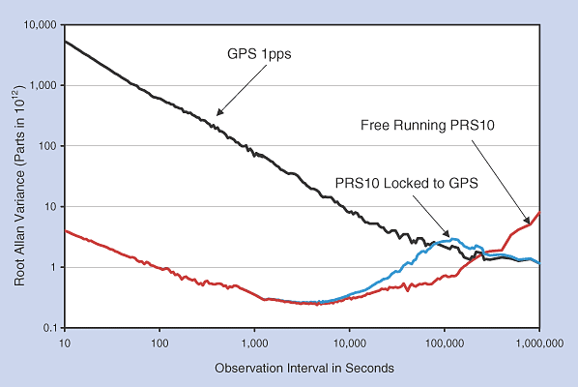
GPS Disciplined Rb Oscillator
Example of a GPS Disciplined Rubidium Oscillator
Credit:
Stanford
Research
Systems
A Rb GPSDO can maintain timing to 20 ns and frequency to 1e-13 at 1 day
Notes:
This plot nicely shows the typical noise level of the raw one-way GPS signal, the stability of a high-quality commercial rubidium oscillator, and the combination of both that provides the better short term stability of the Rb oscillator and the better long term stability of the GPS reference except for some degradation in the intermediate region where the control loop takes effect. The GPSDO performance numbers are those given by NIST at http://tf.nist.gov/time/oneway.htm, and are confirmed in the following data for a very basic GPSDO test setup. Better stability performance can be obtained in the medium term with a better local oscillator, a longer loop time constant and attention to detail regarding the GPS receiver thermal environment and, especially, its antenna placement.
See M.A. Lombardi, “The Use of GPS Disciplined Oscillators as Primary Frequency Standards for Calibration and Metrology”, Measure, Vol. 3, No. 3, September 2008, pp. 56-65 for a nice description of these instruments.

Slide 23
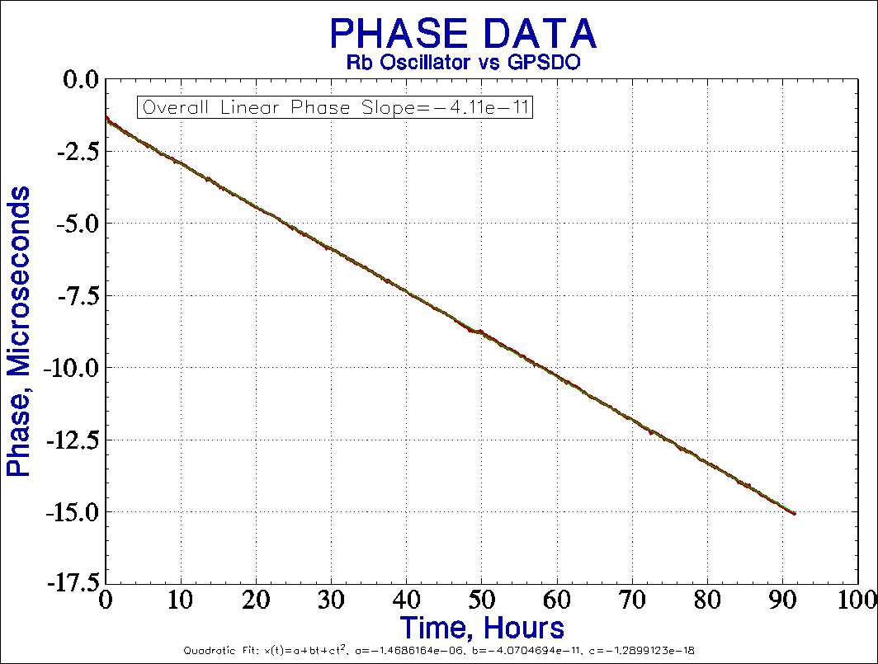
GPSDO Phase Record
Notes:
The 1 second phase record shows the 10’s of ns of short term fluctuations in the one way GPS time transfer. For the purposes of frequency transfer, the main item of interest is the average phase slope which indicates the frequency offset of the local Rb oscillator
The frequency offset can be expressed in several ways. The overall linear slope of the phase record is -4.11e-11. Its overall average frequency is -4.19e-11. Those values are quite similar. Based on the quadratic fit to the phase data, the frequency offset varied from -4.07e-11 at the beginning of the record to -4.16e-11 at the end, a change of -8.51e-13 or about -2.2e13/day which may represent its aging rate (although a longer observation is needed).
Regarding time transfer statistical analysis, the most important point is the value of inspecting the data. Here we can not only see the underlying white/flicker PM noise level but also that the system is subject to a few small disturbances, some initial stabilization, and some slow, perhaps cyclic, wandering. No outliers have been removed from these data, and the disturbances are not outliers but rather fluctuations on the received GPS signal, probably as the satellites in view change, that might be reduced by better antenna placement. Similarly, the slow wandering is probably caused by thermal and barometric pressure variations that could be reduced by a better operating environment. Whether or not more effort is warranted depends on the objective; for the purpose of calibrating a local Rb oscillator over a few days, these data are quite sufficient considering the thermal and barometric environmental sensitivity, and aging, of those devices themselves.
Regarding the phase slope determination, the principal result for a frequency transfer, a linear least squares fit to the phase data is a good choice. The idea is to use a method that yields white residuals, so that is a better choice for data with white PM noise than the average of the frequency data. But here, with the phase disturbances and wandering, that is probably just academic.

Slide 24
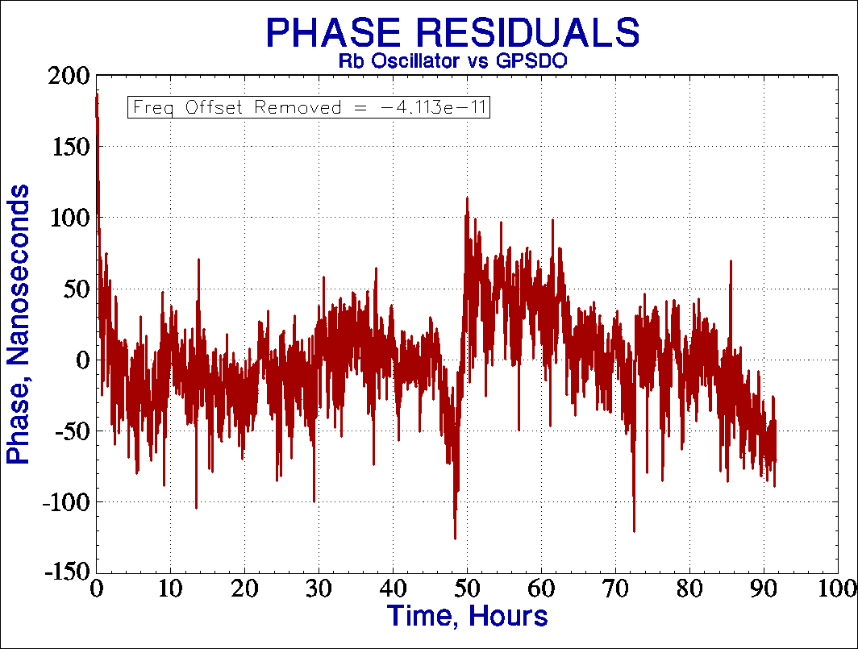
GPSDO Phase Residuals
Notes:
The phase fluctuations can be seen better after removing the least-squares linear phase slope. Frequency is the rate of change of phase. The phase slope in seconds per second is equal to the fractional frequency offset.

Slide 25
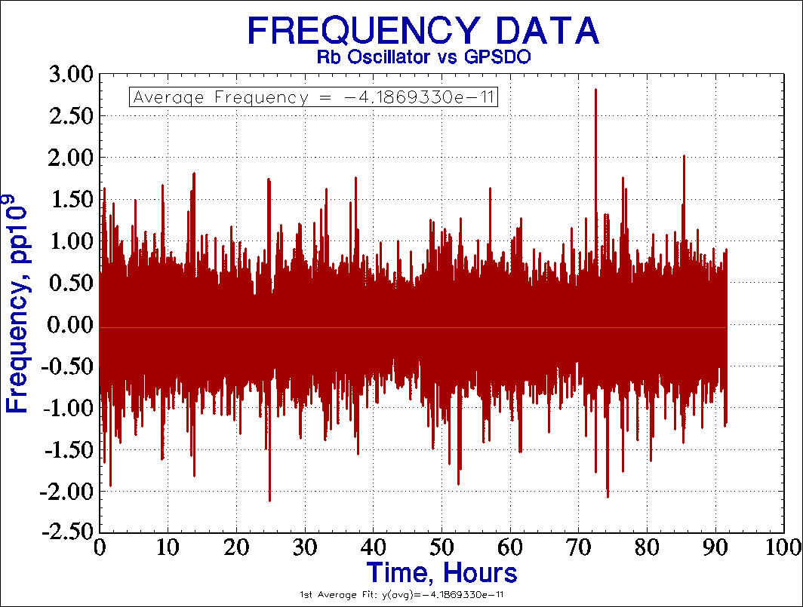
GPSDO Frequency Record
Notes:
It is often useful to also examine the corresponding frequency, which shows the need to average the GPS data over a period of hours. Since the spikes are real data, not outliers, they should not be removed.
One can use a simple GPS time/frequency transfer system to calibrate (syntonize) a local Rb oscillator to within (say) 1pp10¹² in a few hours, as close as matters for a device of that type.

Slide 26
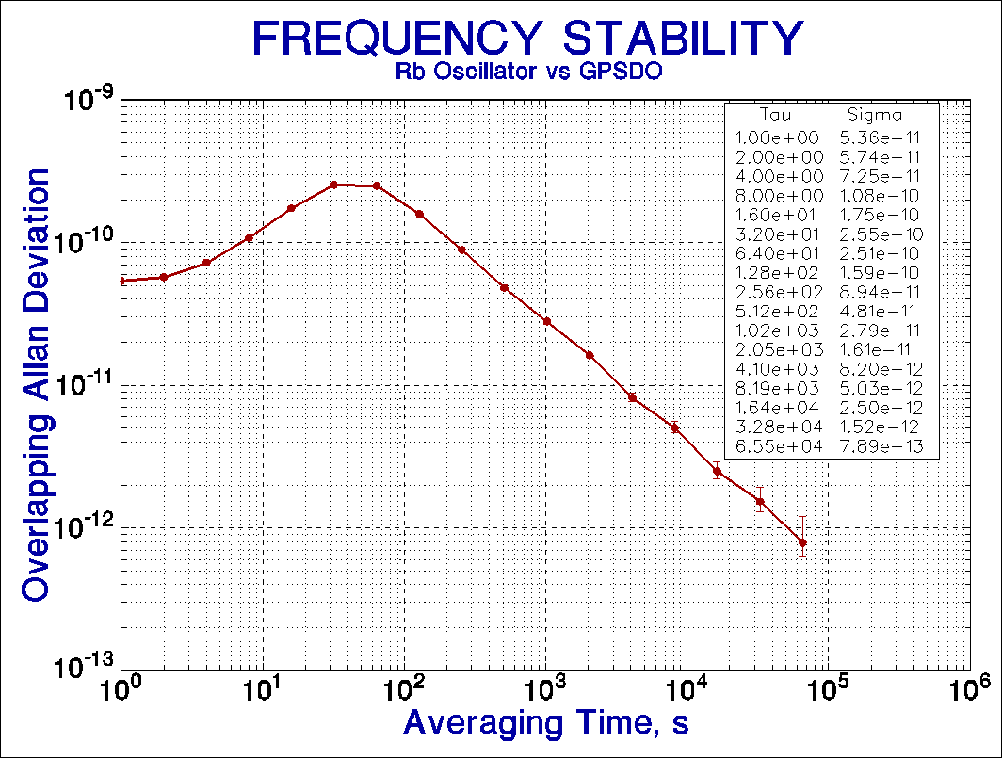
GPSDO ADEV
Notes:
This stability plot is similar to the previous one for the PRS10 GPSDO showing the transition between the local oscillator short term stability and the GPS long term stability. The GPSDO time constant is set approximately where the local oscillator and GPS noise is equal, about 1 minute, which is also about where the ADEV is largest. In this case where the local oscillator is a TCXO, the control loop time constant is shorter than for the PRS10 Rb oscillator. If we say that the GPS instability is a white/flicker PM noise level of 2e-10 at 100 seconds, that corresponds to 2e-8 or 20 ns/s at 1 second, and about 2e-13 at 1 day. The actual GPS noise comes down somewhat slower.

Slide 27
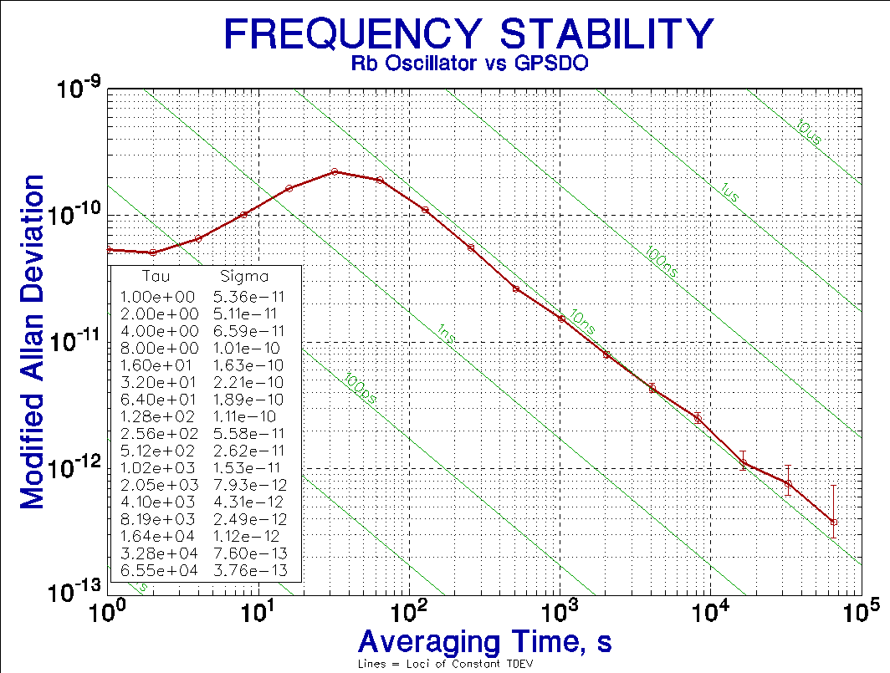
GPSDO MDEV
Notes:
The corresponding MDEV plot (with overlaid loci of constant TDEV) shows that the GPS noise for tau greater than 100 seconds is predominately flicker PM (slope=-1) and has a nearly constant TDEV of about 10 ns.

Slide 28
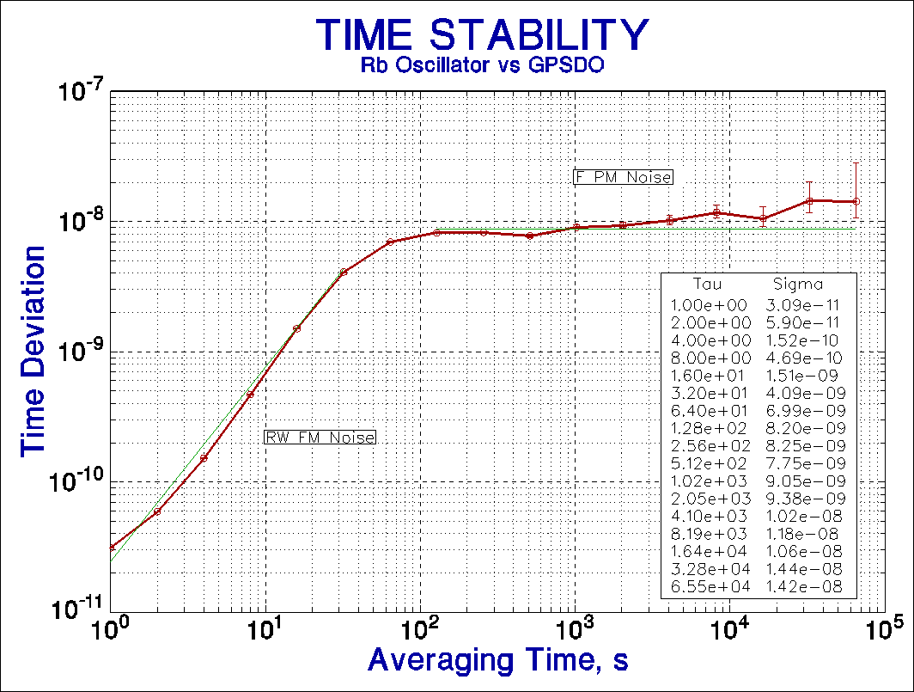
GPSDO TDEV
Notes:
A TDEV plot like this is probably the single best way to assess the performance of a time transfer system since it shows statistically the amount of time error that can be expected over a range of observation times. In the short term, the time error is small because the integration time is small. The time error increases with the averaging time until the opposing effects of longer integration and better noise averaging tend to make the time deviation flatten. One can expect that the time error for even a crude one-way GPS time transfer to be only about ten nanoseconds. For that to have absolute meaning, you also need to know your position to within a few feet, something that GPS can also do, and the instrumental delays (cable lengths, bandpass filters, receiver front end) have to be calibrated. Nevertheless, it’s all pretty amazing when you think about it!
The TDEV plot shows a RW FM noise fit (slope=1.5) at short tau, and a F PM noise fit (slope=0) at long tau, representing regions where the dominant noise sources are the crystal oscillator and GPS time transfer path respectively.

Slide 29
References
W.J. Riley, Handbook of Frequency Stability Analysis, NIST Special Publication 1065, National Institute of Standards and Technology, July 2008.
M.A. Lombardi, L.M. Nelson, A.N. Novick and V.S. Zhang, “Time and Frequency Measurements Using the Global Positioning System”, Cal Lab, July-September 2001, pp. 26-33.
D.W. Allan, D.D. Davis, J. Levine, M.A. Weiss, N. Hironaka and D. Okayama, “New Inexpensive Frequency Calibration Service from NIST”, Proc. 44th Freq. Cont. Symp., pp. 107-116, May 1990.
Notes:
There is a large body of technical literature involving time transfer and the statistics of time and frequency stability. The proceedings of the PTTI meeting are an excellent resource, as are those from the Frequency Control Symposium. Information is available on the web at such places as NIST, and manufacturers data sheets and application notes can be useful. Reference 1 is a comprehensive source of information about frequency stability analysis. Reference 2 is a very nice overview of GPS time and frequency transfer methods. Reference 3 is the classic reference for TDEV; see also D.W. Allan et al, “A Frequency-Domain View of Time-Domain Characterization of Clocks and Time and Frequency Distribution Systems” from the 1991 FCS.

